Slide 1
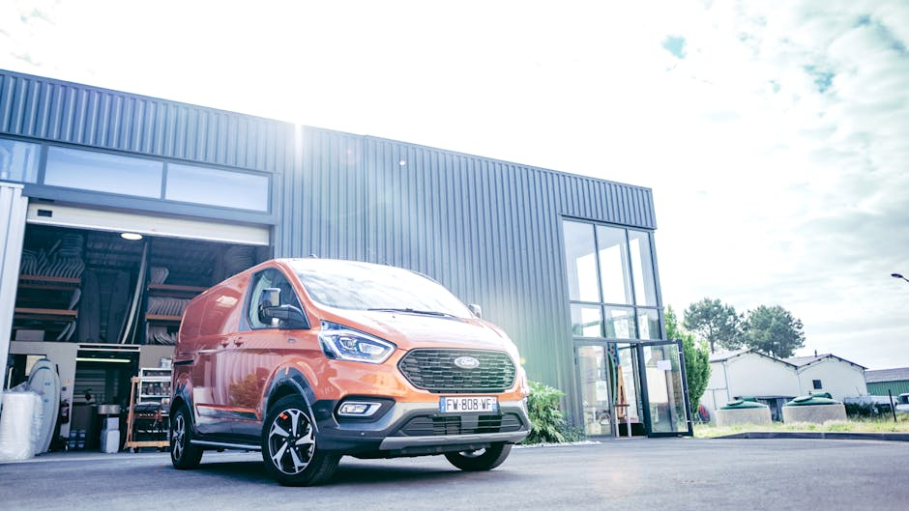
Used Commercial Taxi Market in India
A comprehensive examination of the market landscape for used commercial taxis in India, with a focus on Maruti models. The report provides insights into market dynamics, geographical variations, regulatory impacts, and future projections to aid strategic decision-making for new market entrants.
AI-Generated Presentation • Confidential

Slide 2
Executive Summary
1
2
3
4
5
Market size
Dominant player
Growth drivers
Key strategies
Market outlook
India's used commercial taxi market reached INR 4 trillion in FY2025, with 8-10% projected growth into FY2026
Maruti Suzuki dominates the market due to serviceability
NCR regulations accelerating fleet turnover and vehicle migration to Tier 2/3 cities
Dual-channel sourcing, prioritizing compliant CNG models, robust documentation for financing
8-10% growth in FY2026, driven by increasing demand for used commercial taxis
2

Slide 3
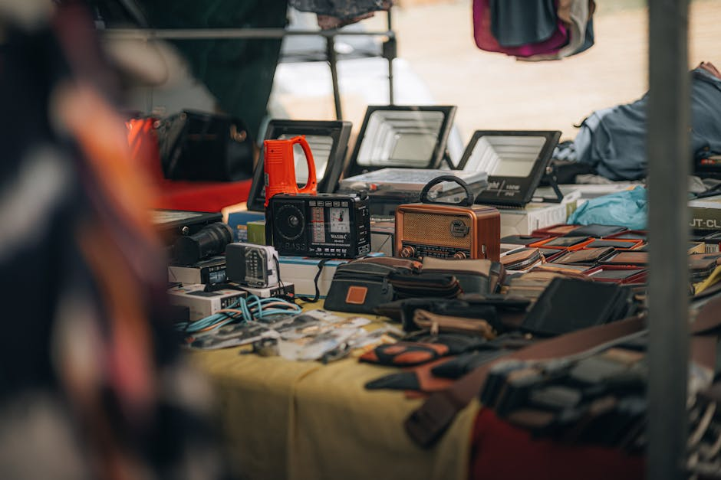
Market size
1
India's used commercial taxi market reached INR 4 trillion in FY2025
Market Overview
Growth rate
2
8-10% projected growth in FY2026
Dominant player
3
Maruti Suzuki dominates the market due to serviceability
Key models
4
Maruti Omni, Maruti Eeco, and Maruti Dzire
Growth drivers
5
NCR regulations accelerating fleet turnover and vehicle migration to Tier 2/3 cities
3

Slide 4
Key Market Indicators
TOTAL MARKET SIZE
GROWTH RATE
DOMINANT PLAYER MARKET SHARE
AVERAGE VEHICLE AGE
INR 4 trillion
8-10%
50%
5 years
FY2025
FY2026
Maruti Suzuki
used commercial taxis
4

Slide 5
India used passenger vehicle market indicators FY2025 to FY2026
METRIC
PERIOD
VALUE
SOURCE
Used car transactions (Units)
FY2025
5,900,000
Indian Blue Book coverage via IBEF and Moneycontrol 3.
Used car market value (INR)
FY2026 outlook
4,000,000,000,000.00
Crisil estimate reported by Business Standard 4.
Used car volume growth (Percent)
FY2026 outlook
8.0% to 10.0%
Crisil projection reported by Business Standard and ETAuto 1.
Taxi registrations (Units)
CY2025
312,665
Vahan portal data cited by Mint 2.
4 records · 4 metrics · Source: Document Analysis
5

Slide 6
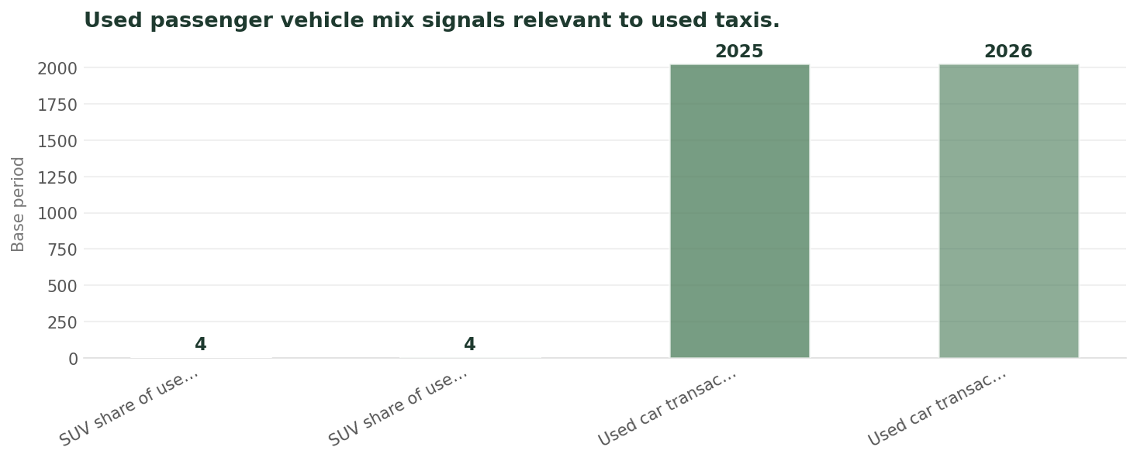
Used Passenger Vehicle Mix
Data visualization from document analysis
📊
6

Slide 7
Key Strategies
01
02
03
04
Dual-channel sourcing
Prioritizing compliant CNG models
Robust documentation for financing
Model-specific pricing
Sourcing vehicles from both organized and unorganized sectors
Focusing on CNG models to comply with regulations
Ensuring proper documentation for financing
Pricing vehicles based on their specific models and conditions
7

Slide 8
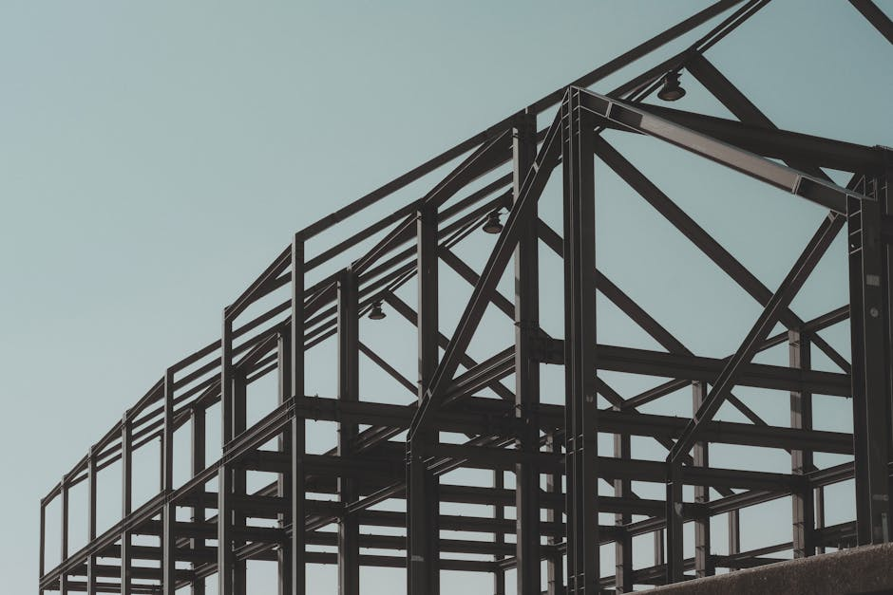
NCR regulations
1
Accelerating fleet turnover and vehicle migration to Tier 2/3 cities
Regulatory Framework
CAQM end of life fuel denial rollout
2
Phasing out old vehicles to reduce pollution
Vehicle age limits
3
Limiting the age of vehicles to ensure safety and reduce pollution
Compliance requirements
4
Ensuring vehicles comply with regulations to avoid penalties
Penalties for non-compliance
5
Imposing penalties on vehicles that do not comply with regulations
8

Slide 9
Market Dynamics
Supply and demand
Pricing trends
Vehicle availability
Financing options
Balance between the supply of and demand for used commercial taxis
Trends in pricing of used commercial taxis
Availability of vehicles in the market
Options available for financing used commercial taxis
9

Slide 10

Future Market Projections
India's used commercial taxi market is projected to grow at 8-10% in FY2026
INR 4 trillion: Market size in FY2025
5.9 million: Number of units in FY2025
Maruti Suzuki: Dominant player in the market
10

Slide 11
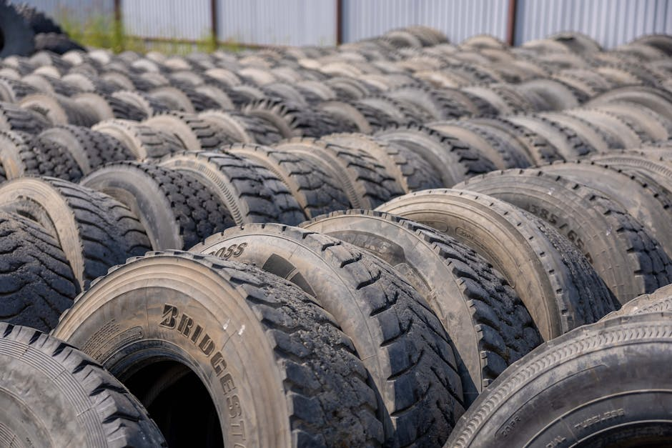
Key takeaways
1
Summary of the key findings and insights from the report
Conclusion
Market outlook
2
8-10% growth in FY2026, driven by increasing demand for used commercial taxis
Strategic recommendations
3
Dual-channel sourcing, prioritizing compliant CNG models, robust documentation for financing
Future projections
4
India's used commercial taxi market is projected to grow at 8-10% in FY2026
Growth opportunities
5
Opportunities for growth and development in the used commercial taxi market
11

Slide 12

Key Takeaways
→
India's used commercial taxi market reached INR 4 trillion in FY2025
→
8-10% growth projected in FY2026
→
Maruti Suzuki dominates the market due to serviceability
→
NCR regulations accelerating fleet turnover and vehicle migration to Tier 2/3 cities
→
Dual-channel sourcing, prioritizing compliant CNG models, and robust documentation for financing are key strategies
12

Slide 13
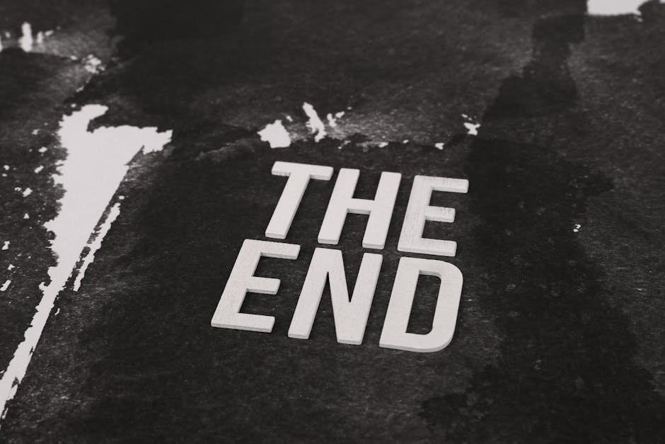
Final Thoughts
→
India's used commercial taxi market is a growing and dynamic market
→
Key players must adapt to changing regulations and market trends
→
Opportunities for growth and development exist in the market
→
Strategic planning and execution are essential for success
→
Continuous monitoring of market trends and regulatory changes is necessary
13

